Slide 1
Exploratory Data Analysis Car Sales Data
Submitted By : Shubha P . C.

Slide 2
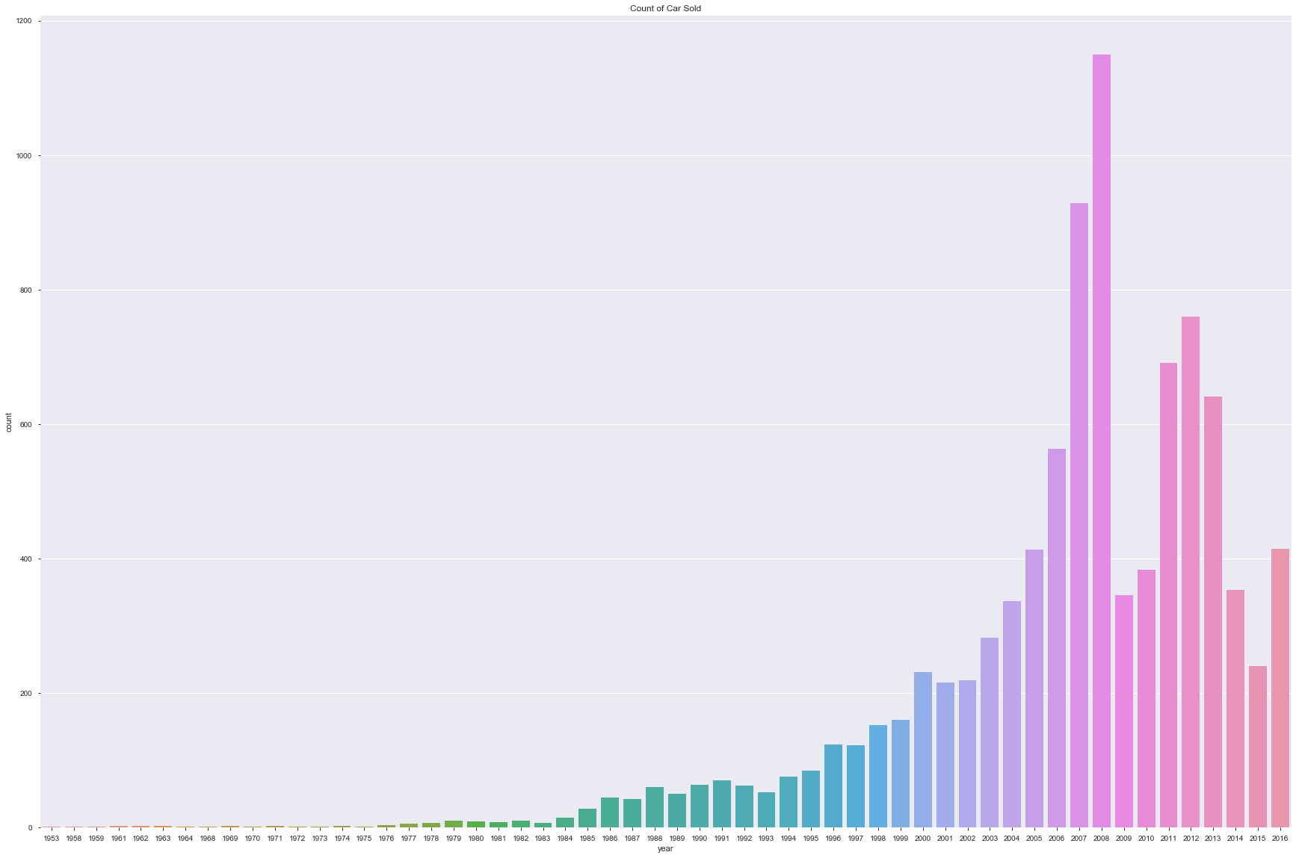
Which year had the highest car sale
Highest sale was recorded in the year 2008 and minimum sale of cars were during the period 1953 to 1980 when the sale was in single digit

Slide 3
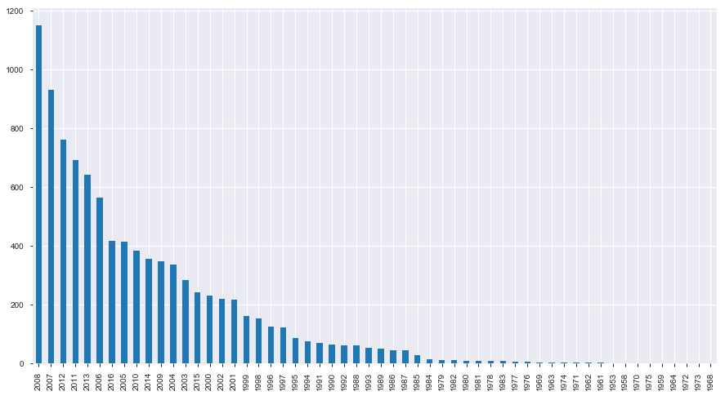
Which years did the maximum sale of car happen
Years 2008, 2007 and 2012 topped the sales with a record high of 1158 cars being sold in 2008 against the 1 single car sold in 1953 and the consecutive decade

Slide 4
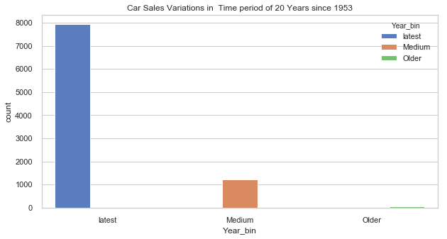
How is the Car Sales Trend in timeframe of 20 years
Latest : Years :2000 – 2016
Medium: 1980 – 2000
Older: 1953 – 1980
The above graph shows the surge in car sales after year 2000
Car Sales was less than 50 from 1953 to 1989. Car Sales improved a lot the following years and crossed 200 after 2000. Expensive cars found market since the year 2000
In the graph, 2000 to 2020 sale is 8 times more than the previous timeframe ( 1980 - 2000)

Slide 5
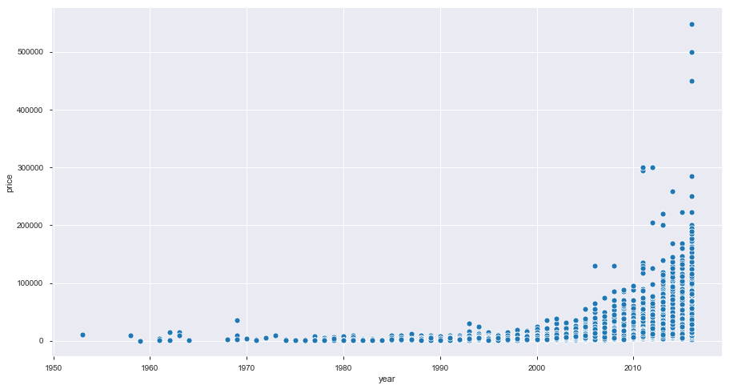
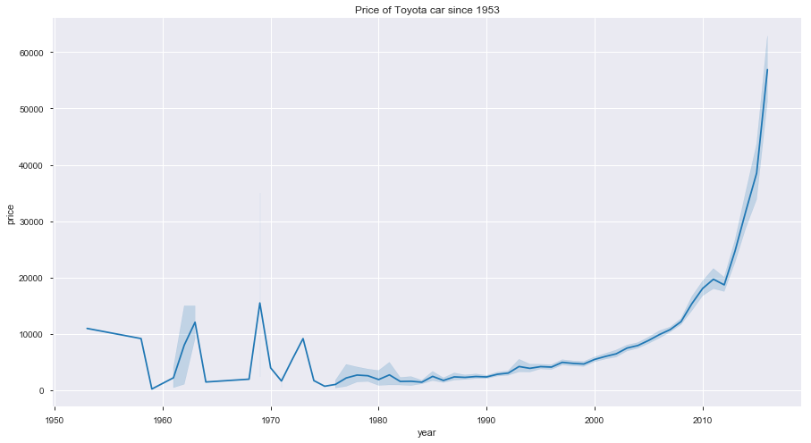
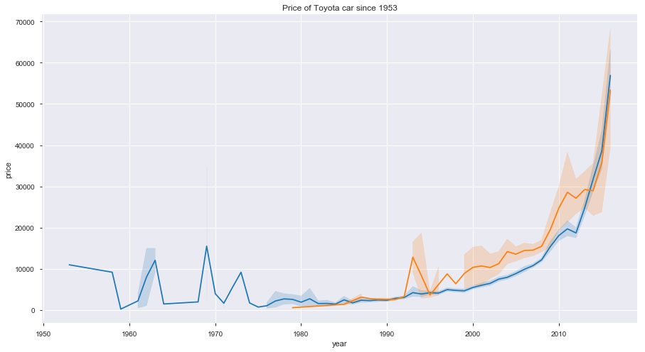
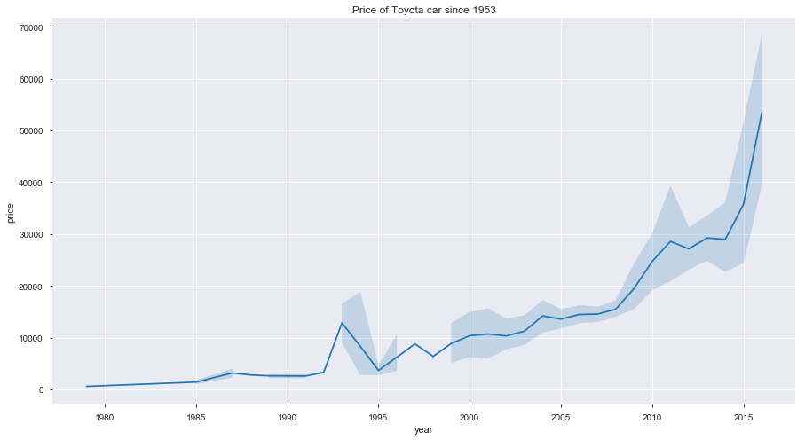
What is the car price trend since 1953
There has been a steady increase in price between year 1953 and 2000. Price has increased substantially since 2000 and is quite high since year 2011. There are outliers since 2007 onwards. This means that cost of cars have had a gradual increase in price. Example: Toyota car sale that began with as low as 600 in 1979 has a price tag of 99999

Slide 6
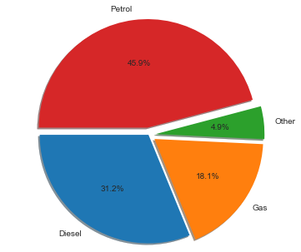
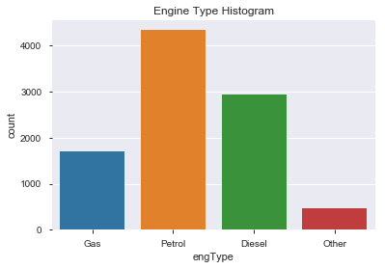
Which Engine Type sold the most
Petrol Engine sale was maximum with nearly 50 percent followed by Diesel which was 30 percentage and Gas engine sale was 15 percentage and Others was 5 percentage

Slide 7
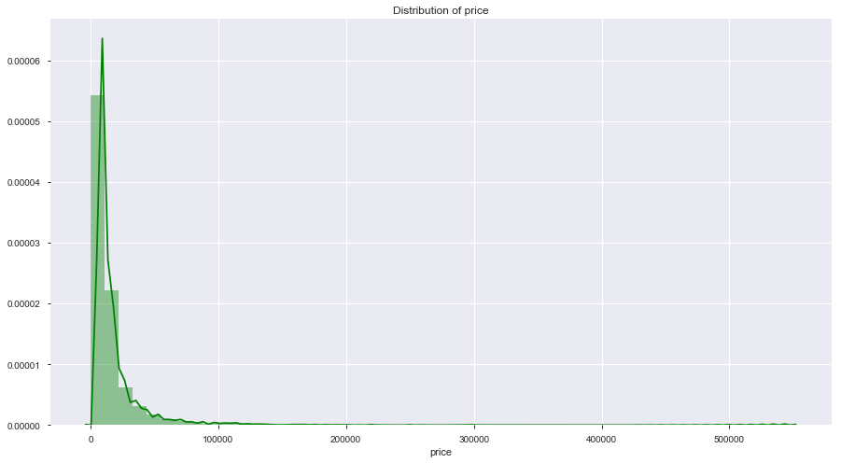
What has been the distribution of price
Price mostly is in the range 0 to 100000. Very few cars has price range above 100000

Slide 8
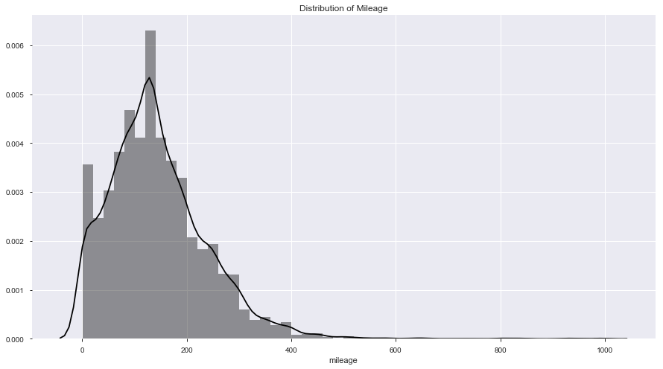
What has been the distribution of mileage
Mileage lies mostly in the range 90 to 250. There has been outliers with mileage 1 , 2 etc that has been recorded

Slide 9
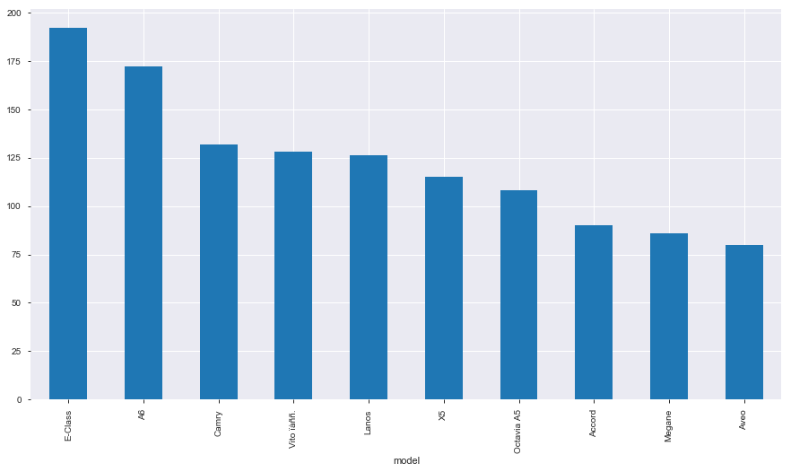
Which car model sold most
Model E-Class was the most popular followed by A6 and Camry in the 2nd and 3rd Position

Slide 10
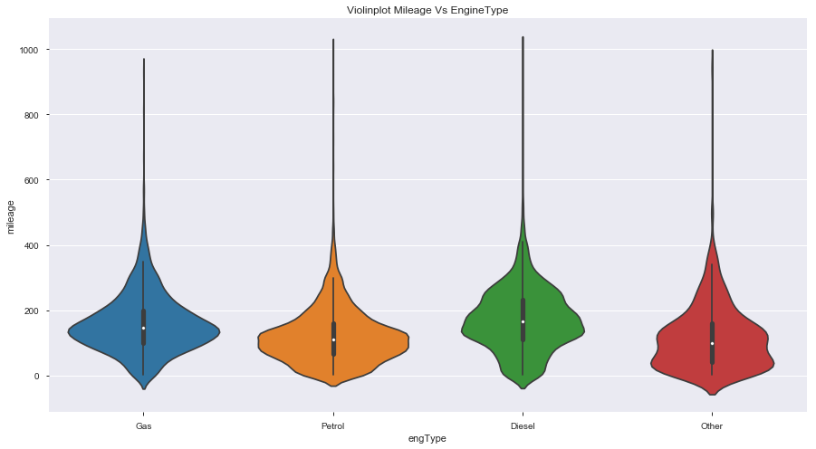
What is the correlation between Mileage and Engine Type
Mileage is higher for Diesel Engines and Gas Engines compared to Petrol and Other

Slide 11
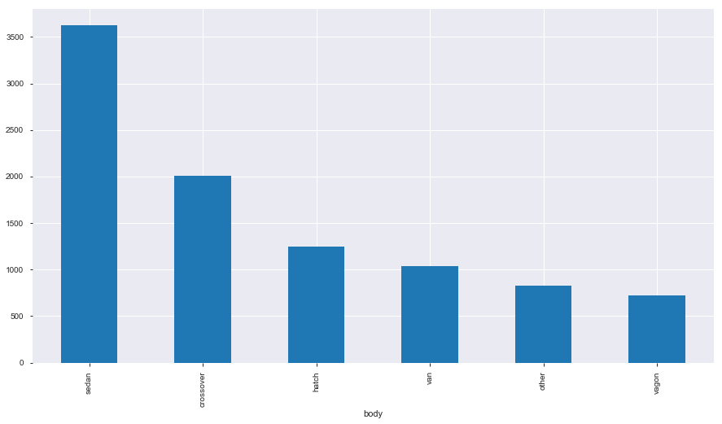
Which cars sold most based on car size (body)
Highest body type sold was sedan followed by crossover and hatchback. Vagon was the least sold model

Slide 12
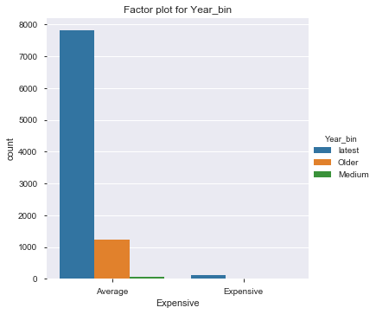
What is the percentage of cars in the Year_bin that fall in the range "Expensive" and "Average"
Expensive cars (Price > 100000) have been sold after year 2000.
No expensive cars have been sold before year 2000

Slide 13
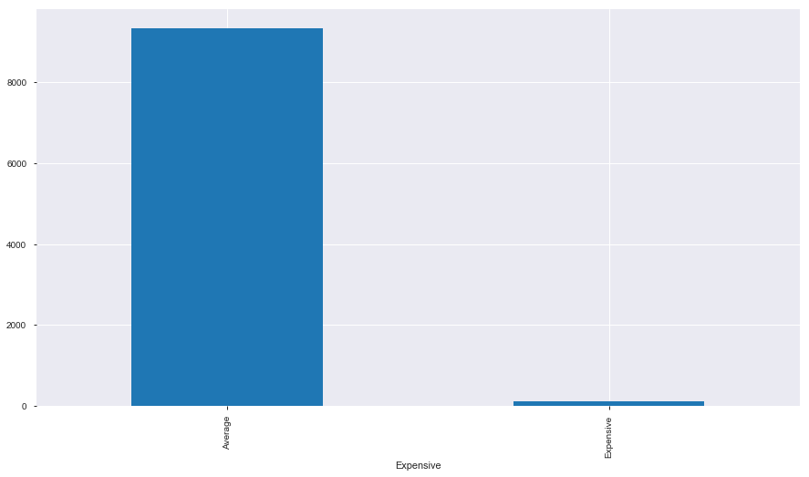
What is the proportion of expensive cars that are sold
Expensive cars that are sold is less than 2 percentage of the total cars that are sold
( Expensive is those cars where price > 100000)

Slide 14
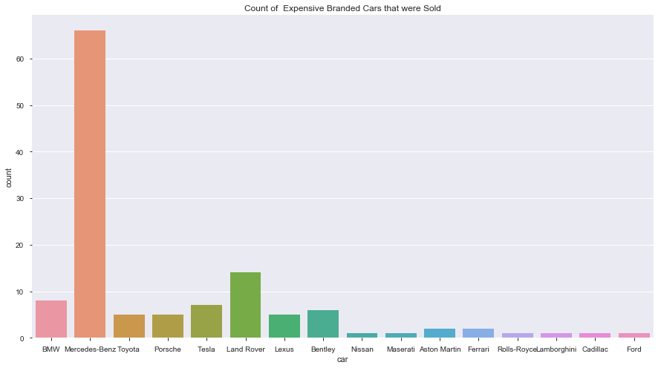
Which are the expensive branded cars and how many of them sold
Mercedes Benz car sold the most in the Expensive variety followed by Land Rover in the second position and BMW. Benz car sale was nearly 5 times more than sale of Land Rover and nearly 8 times more than the sale of BMW. Among the expensive range Nissan, Rolls Royce, Lamborghini, Cadillac and Ford sold least. Medium sales was recorded for Toyota, Porsche , Lexus, Bentley

Slide 15
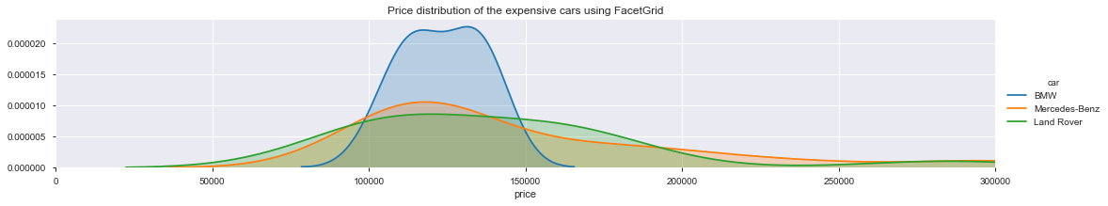
What is the price range for the top 3 expensive cars that have been sold
Price varies from 50000 to 300000 for the expensive cars with Land Rover starting from a little below 90000 to 30000. Benz price ranges are also quite similar. However BMW price range is from 80000 to 120000. This implies that Land Rover and Mercedes-Benz has more price class with full/medium/start options and various other accessories options. BMW has narrower price distribution and accessories options. BMW pricing is more on a fixed scale. It is therefore observed that the greater prize flexibility the better the sale.

Slide 16
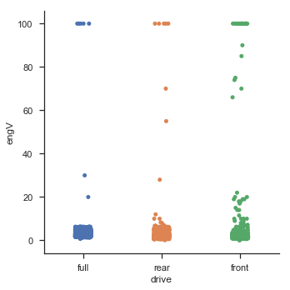
What is the correlation between wheel drive and engine capacity
Front Wheel drive has greater engine capacity as compared to rear wheel drive and front wheel drive

Slide 17
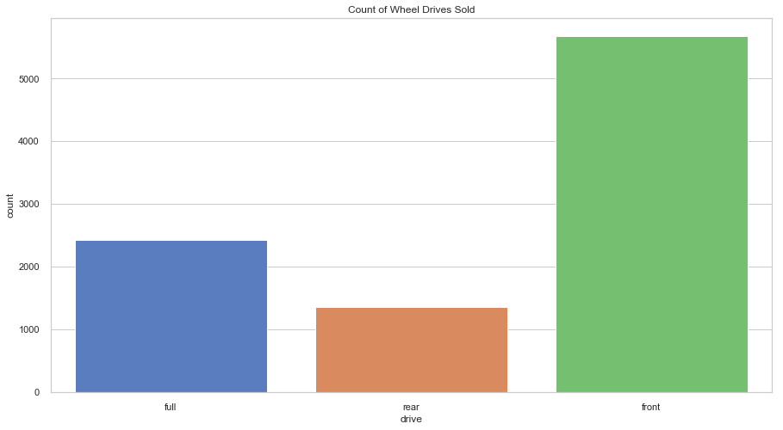
What is the car sale type based on Wheel Drive
Front Wheel Drive has the highest sales followed by Full Wheel and least sale is for Rear Wheel Drive

Slide 18
What is the percentage of non registered cars
Nearly 2 percentage of cars are not registered. The cars not registered in the country means these have arrived from another country with foreign registration

Slide 19
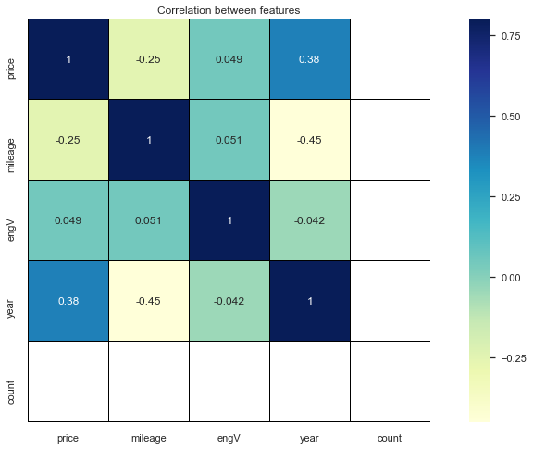
What is the correlation between price, mileage, engV and year
Mileage and Price and positively corelated with Year
engV is negatively corelated with year
There is high corelation between price and year
With high corelation we face redundancy issues

Slide 20
Conclusion
Car Sales has increased over the years and a remarkable increase can be seen after the year 2000
Price has increased exponentially since 2011
Highest car sale was recorded in the year 2008
Years 2008, 2007 and 2012 marked the top 3 car sale years
Expensive cars such as Benz, BMW, Land Rover sale has picked up since 2000
Front Wheel Drive has the highest market value as Front Wheel drive has greater engine pickup
Sedan, crossover and Hatchback are the highest demand car types in the market
Mileage is highest for Petrol followed by Diesel engine, Gas and Others
There are few non registered cars from other countries which is less than 2 percentage
More the price flexibility and car options, the better the car sales .Example Benz Car Sale
Mercedes Benz is the most popular branded model
Sale of Cars with Petrol Engine sale is maximum as Petrol Engine has the highest mileage compared to others
Market for Expensive Cars is mostly in the elite class as very few are sold . Average car sale is very high as against branded models as more middle class customers can afford
Average Car Price mostly is < 10 Lakhs. Expensive models with full option cost > 10 Lakhs

Slide 21
Thank you

